Slide 1
FMD Data Sources
Sources of data,
the Intent &
Target customer
Provided by Facilities Inventory
Facilities-inventory@fmd.uga.edu

Slide 2
Content
Plansroom (repository for all digital and hard copy construction documents)
MultiVista (mobile app to access relevant construction documents on the fly)
AiM-BIM (building information model with the ability to extract information about equipment and input into AiM)
GIS (geographical information mapping for underground and overhead utilities)
AiM-Property (building information maintained in AiM (names, numbers, sq ftg, use, rooms, department assigned, etc.)

Slide 3
Plansroom
The Facilities Inventory Plansroom houses most construction documents for UGA buildings. Our digital floor plan files can be accessed online using your UGA MyID. The construction documents are available by request to facilities-inventory@fmd.uga.edu.
These are the design, construction, and as built documents and O&M Manuals associated with facilities and utilities on and off main campus and are used by students, FMD Operations & Maintenance, Engineering, and Construction departments, the Office of University Architects and the many design professionals that work on UGA projects.
Contact us
Facilities-inventory@fmd.uga.edu

Slide 4
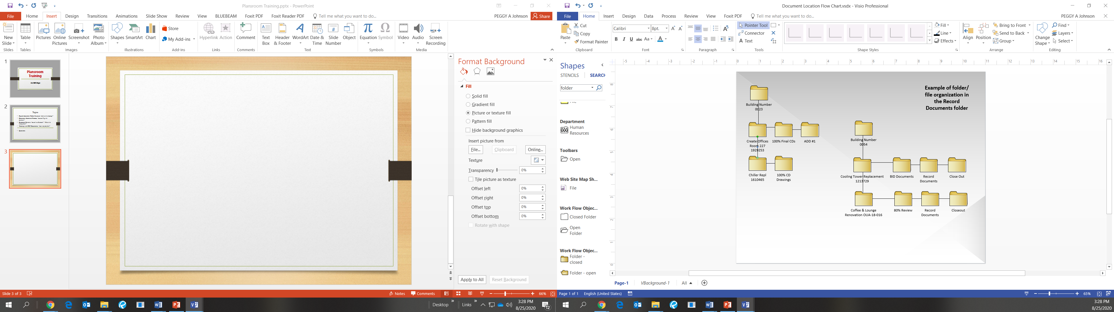
Digital document Folder Structure
We are staffed to assist if needed but please contact us ahead of time to insure someone is available.
Contact us ahead of time (facilities-inventory@fmd.uga.edu) and we can pull what you need and have it waiting.
We also provide basic floor plans for all campus buildings in PDF and hard copy. These identify room numbers, room uses and square footages.
*Actual folder structure may differ from example depending on what is submitted for each project.
We are located in room 250 in the Chicopee 1 building and are open Monday thru Friday from 7am-5pm.

Slide 5

MultiVista
Multivista is a user friendly visual construction documentation application used as a platform to provide interactive access to relevant building information and documentation for repairs and maintenance on site.
Multivista is not intended to replace the plansroom and will not contain all documents for a building. Multivista will be tailored to contain the relevant information requested by FMD.

Slide 6

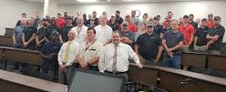
Currently
At this time the location information for shut offs and equipment in the form of push pens is being added to our basic floor plans. In the future we plan to upload corresponding documents (drawings and O&M manuals) and link the push pens to these documents.
OUA currently uses Multivista for new projects that include construction document access, time stamped photos of the construction project, and drone imaging of site development during construction.
Potential customers include FMD maintenance & repair personnel, OUA & FMD Project managers and Design Professionals

Slide 7
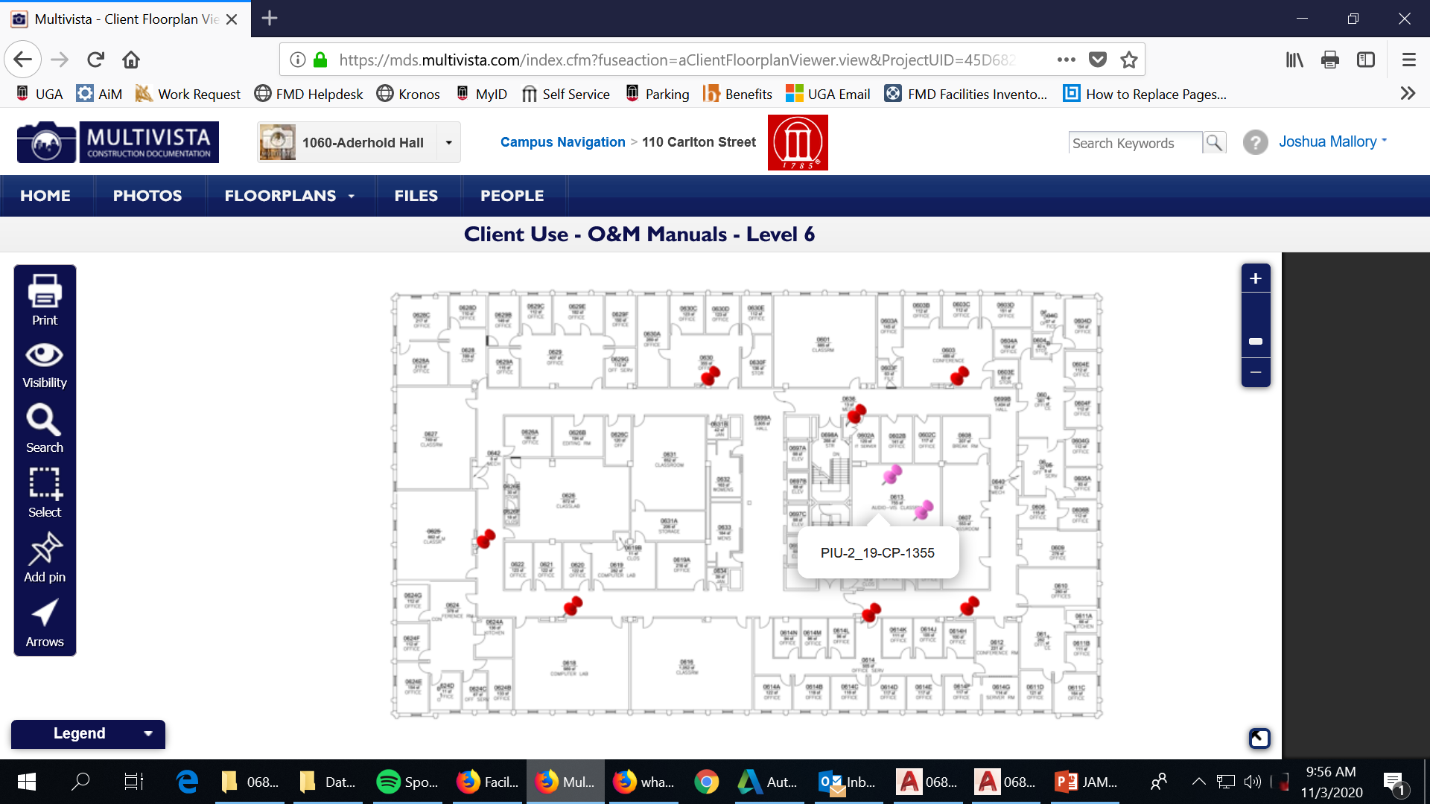
What it looks like…
The push pens are color coded to the matched utility using nationally recognized designated colors. Hovering over a push pen shows a pop-up with a brief description. In this case (PIU-2_19-CP-1355) shows the VAV Powered Induction Unit with the project number. Once links have been established; users will be able to click a push pen and bring up the related documents.

Slide 8
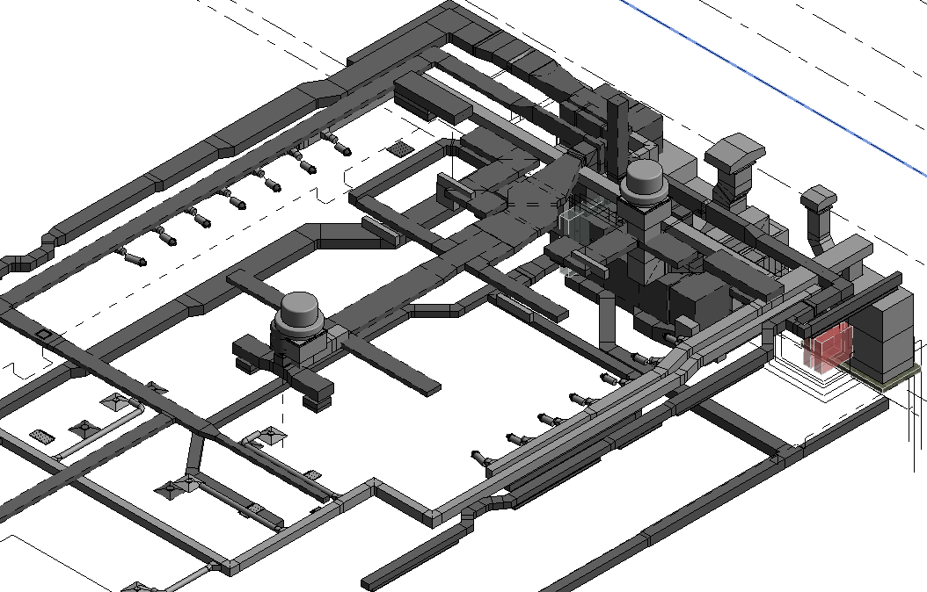
BIM
(AiM Equipment Module)
BIM or Building Information Modeling and is the process of creating design drawings in 3D with the capability of attaching physical and functional information to equipment, walls, floors, etc. This process provides a way to save both time and money by developing an efficient workflow that identifies conflicts during the design process instead of during construction.
BIM also facilitates the extraction of information using COBIE that can be input into database systems like AiM. This gives the ability to streamline the process of gathering valuable information and providing quick access when needed.
FMD has a limited inventory of BIM models and is currently in the process of defining what information will most benefit Facilities Management and provide improvements in efficiency for our equipment inventory, preventative maintenance, and repair personnel. Our goal is to capture what is most relevant while considering the resource and monetary cost and balance the two for the most efficient outcome.

Slide 9
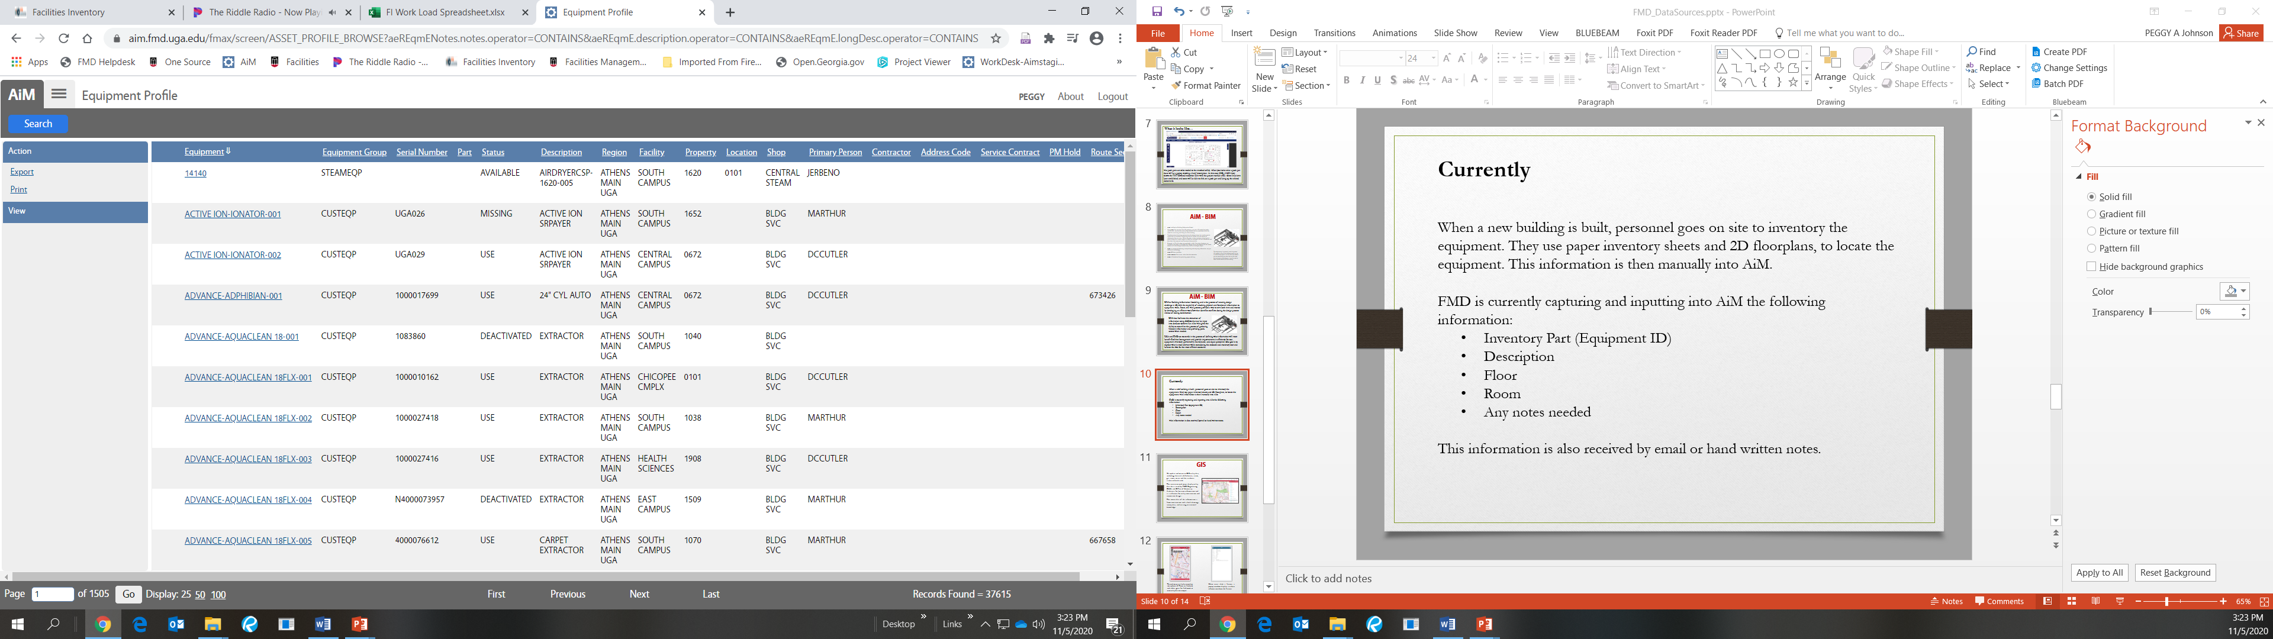
Currently
When a new building is built, personnel goes on site to inventory the equipment. They use paper inventory sheets and 2D floorplans, to locate the equipment and note relevant informaton. This information is then manually entered into AiM.
For existing buildings changes are received by phone, email or hand written notes.
FMD is currently capturing and inputting into AiM the following information:
  Inventory Part (Equipment ID)
  Description
  Floor
  Room
  Any notes needed

Slide 10
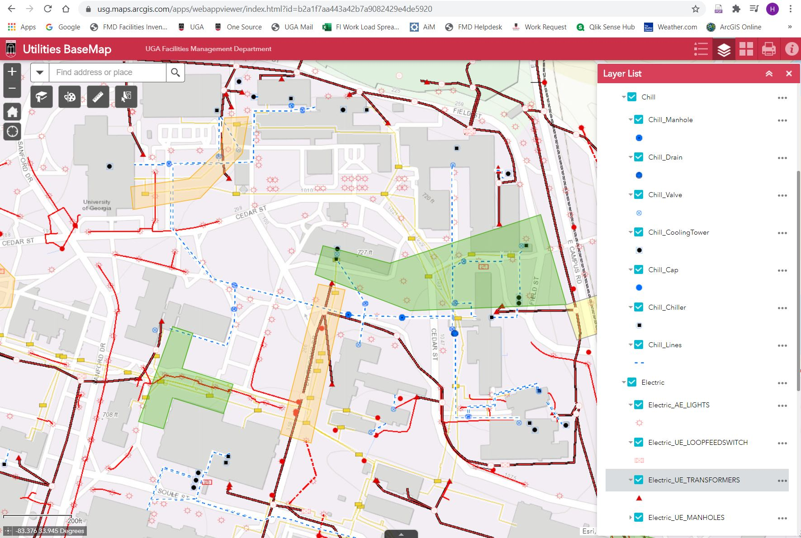
GIS
Currently we are collaborating with OUA to update and maintain GIS utility data, including electrical, chilled water, steam, gas, sewer, water and the attributes associated with each.
The interactive web maps display utility data that is used by FMD Engineering, O&M, and OUA for location information and as a reference for utility construction and renovation design.
The source data of this information comes from construction and as built drawings, survey data, and existing institutional knowledge.

Slide 11
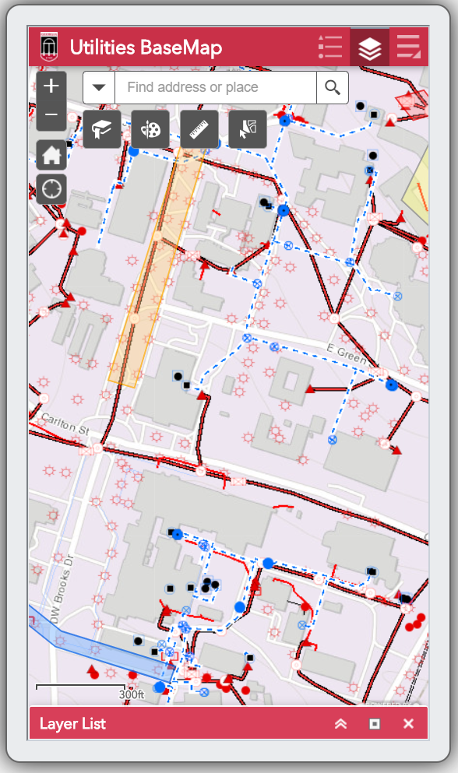
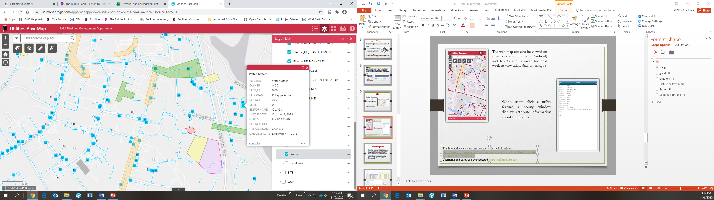
The web map can also be viewed on smartphones (I Phone or Android) and tablets and is great for field work to view utility data on campus.
When users click a utility feature a popup window displays attribute information about the feature. Example to the right is information for the Water_Meters.
The interactive web map can be access via the link below.
https://usg.maps.arcgis.com/apps/webappviewer/index.html?id=b2a1f7aa443a42b7a9082429e4de5920
Username and password by requested helpdesk@fmd.uga.edu

Slide 12
AiM - Property
AiM property data is collected and maintained in AiM, BLLIP, Oracle Tables, and other resources to provide updated building information. This includes names, numbers, square footage, cost/value, construction and renovation dates and costs, room uses and occupancy, department assignment used for budgeting, staffing, class scheduling, and funding requests. This information is essential for university accreditation, maintenance funding requests, budget forecasting, space allocation as well as staffing, maintenance, and repair of UGA buildings.
This information and related reports are used by University System of Georgia BOR, FMD Maintenance Project Management and Engineering, Work Request, Operations and Maintenance, Space Management, Registrar’s Office, Institutional Research, Real Estate Office, Insurance and Claims, Property Control, UGA Mart, and many other UGA departments.

Slide 13
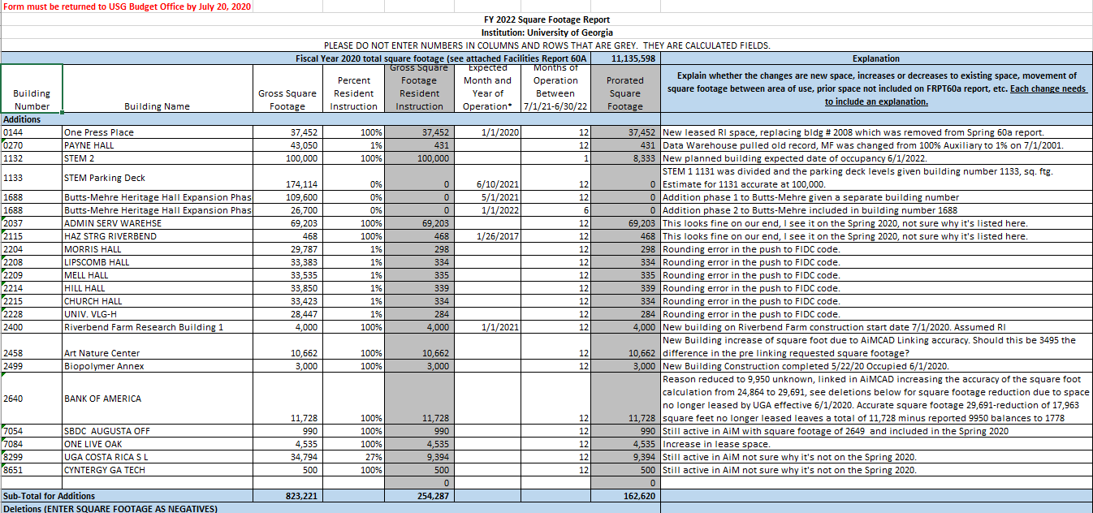
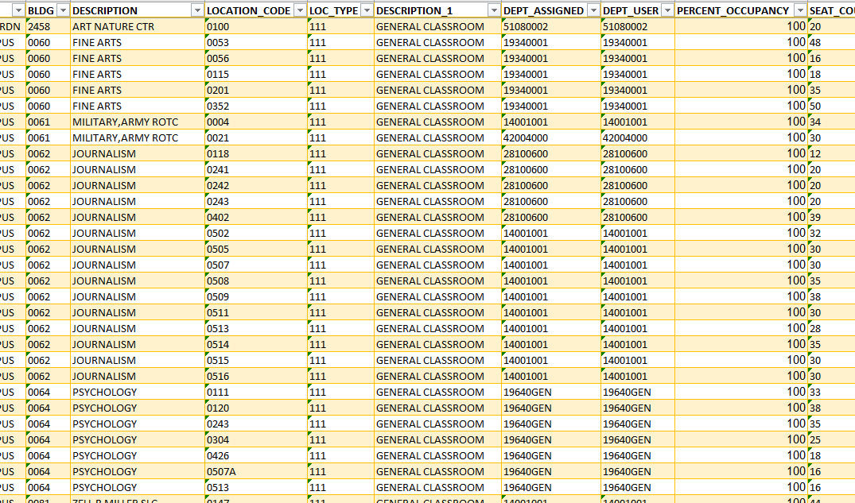
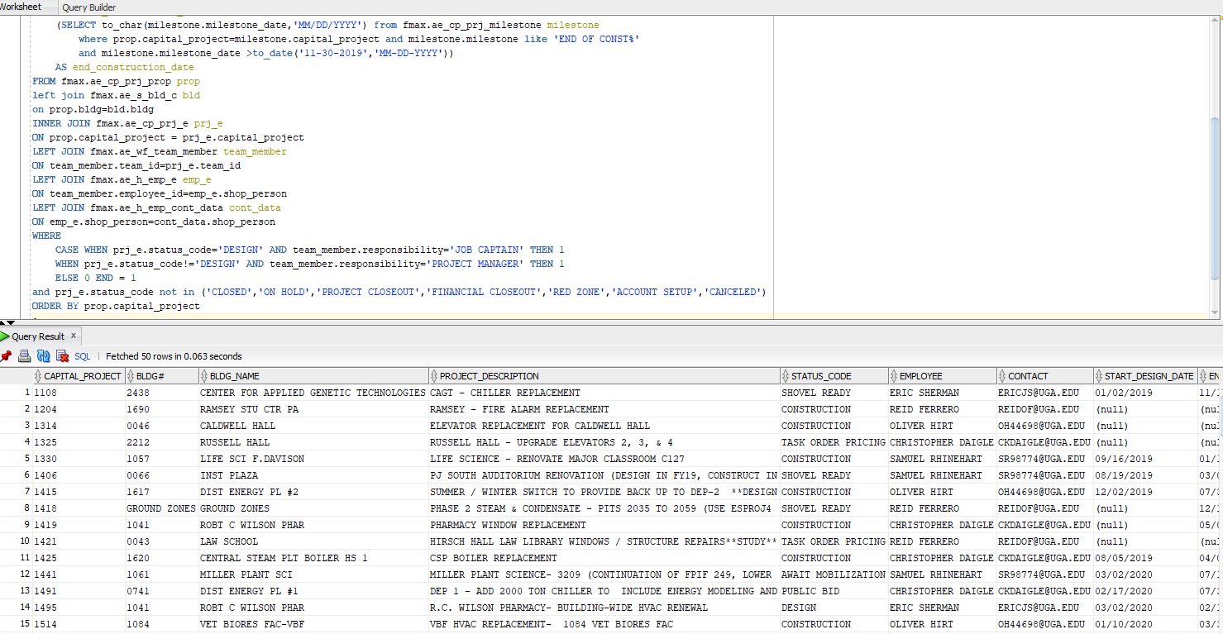
Square Footage Report: this template from USG is used to report new buildings, deletions, additions, and square footage change estimates for the next 2 years and is the bases for MRR funding requests.
Building or Space Report: this is a sample of a report used by the Registrar's Office, Space Management and facility users for better management and space utilization.
FMD Capital Project Report: this is a report created in SQL Developer and is then imported into the GIS system to create the Capital Project GIS map.
Send information requests to facilities-inventory@fmd.uga.edu

